Slide 1


PANIMALAR ENGINEERING COLLEGE
Department of Computer Science and Engineering
Project Review II , 05/04/2021
Sleep Apnea Detection
Project Guide:
M Krishnamoorthy
Asst Professor
Panimalar Enginerering College
A.GOKUL REDDY(211417104005)
A.HARIVIKASH(211417104019) Ch.JEEVAN KALYAN(211417104041)
BatchNumber:E17

Slide 2
INTRODUCTION
Data Mining
Data mining is the process of discovering patterns in large data sets involving methods at the intersection of machine learning, statistics, and database systems.
An interdisciplinary subfield of computer science, it is an essential process — wherein intelligent methods are applied to extract data patterns— the overall goal of which is to extract information from a data set, and transform it into an understandable structure for further use.
Aside from the raw analysis step, it involves database and data management aspects, data pre-processing, model and inference considerations, interestingness metrics, complexity considerations, post-processing of discovered structures, visualization, and online updating. Data mining is the analysis step of the "knowledge discovery in databases" process, or KDD.

Slide 3
LITERATURE SURVEY

Slide 4
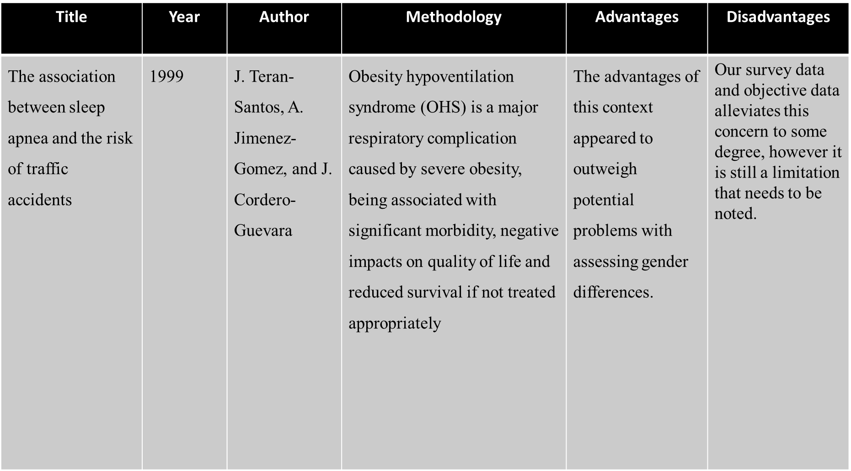

Slide 5
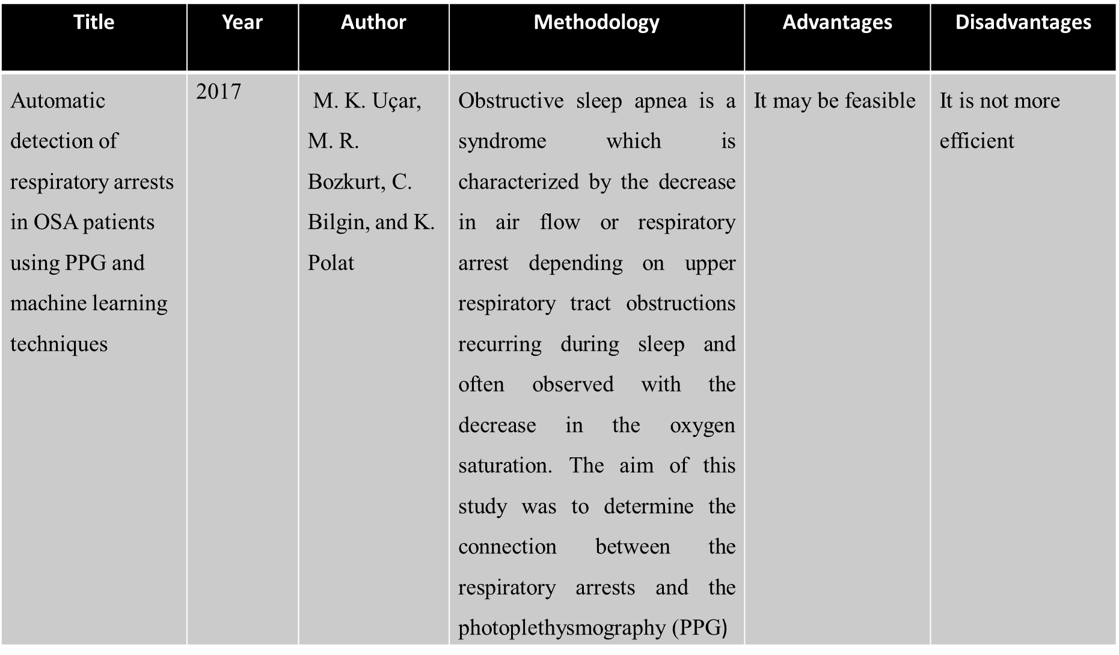

Slide 6
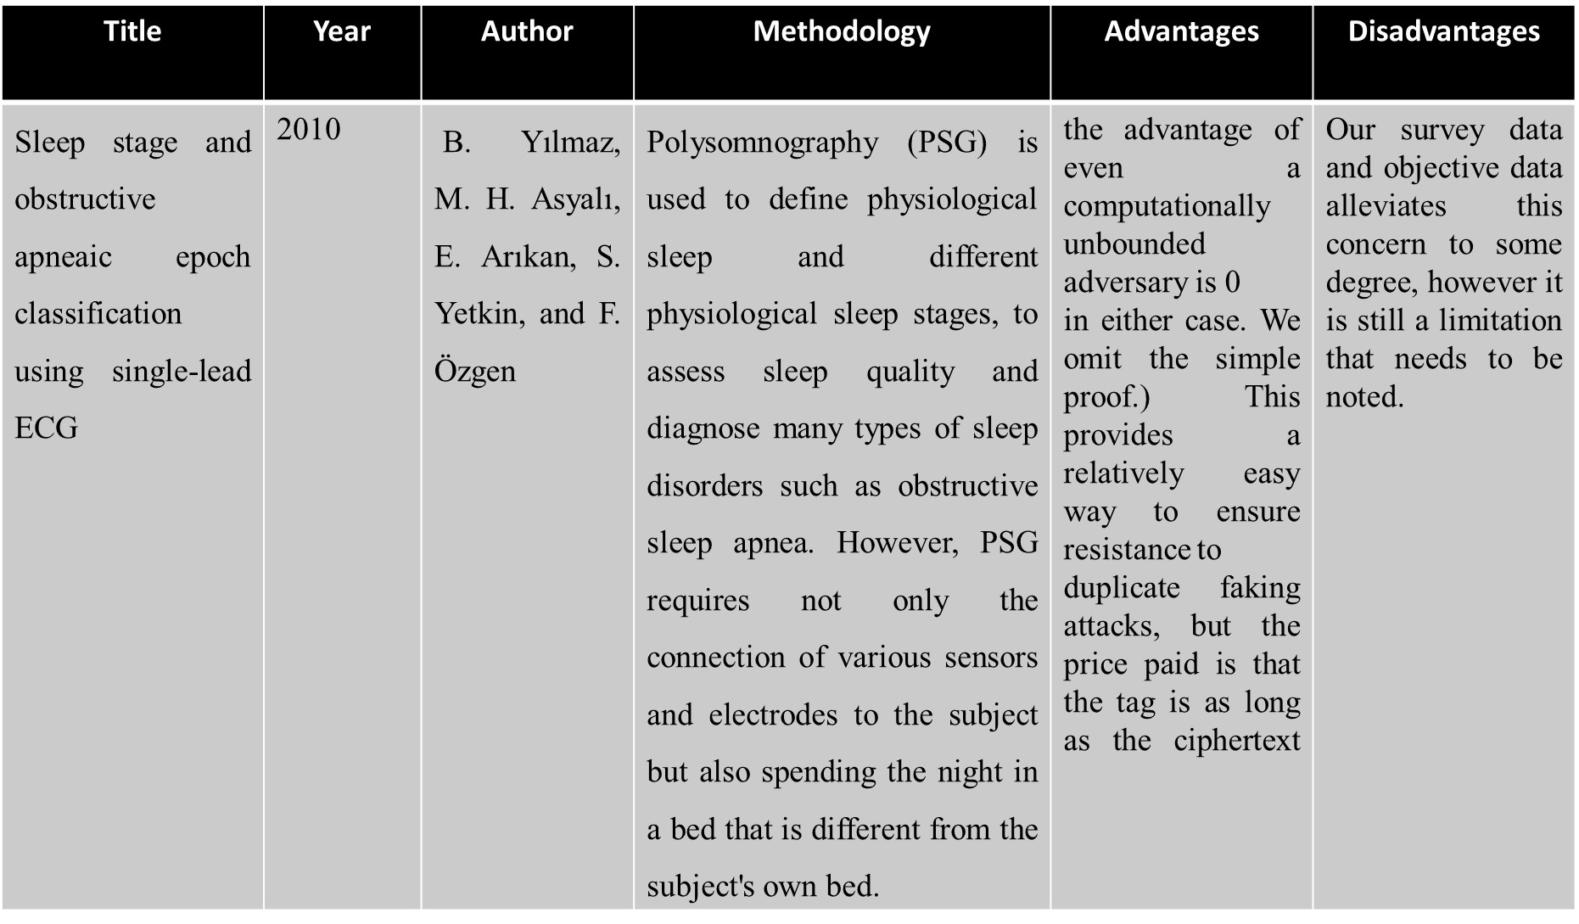

Slide 7
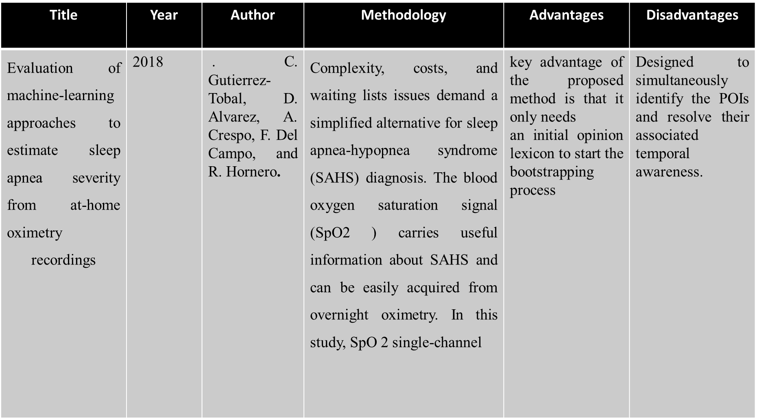
Title | Year | Author | Methodology | Advantages | Disadvantages
Evaluation of machine-learning approaches to estimate sleep apnea severity from at-home oximetry recordings | 2018 | . C. Gutierrez-Tobal, D. Alvarez, A. Crespo, F. Del Campo, and R. Hornero. | Complexity, costs, and waiting lists issues demand a simplified alternative for sleep apnea-hypopnea syndrome (SAHS) diagnosis. The blood oxygen saturation signal (SpO2 ) carries useful information about SAHS and can be easily acquired from overnight oximetry. In this study, SpO 2 single-channel | key advantage of the proposed method is that it only needs an initial opinion lexicon to start the bootstrapping process | Designed to simultaneously identify the POIs and resolve their associated temporal awareness.

Slide 8
ABSTRACT
Obstructive Sleep Apnea (OSA) is a common, but severely under-diagnosed sleep disorder that affects the natural breathing cycle during sleep with periods of reduced respiration or no airflow at all.we achieve an accuracy of 96.6% with a combination of respiration data from the blood pressure as input data. We use K-Nearest Neighbor algorithm. We update the dataset to sql.The data is only slightly preprocessed.In this process also achieved a good result with the simple KNN technique. We focus in this study on respiratory signals from the blood pressure saturation.We get the information fetch the important data from sql. We use K-Nearest Neighbor algorithm to get nearest Value for disease .

Slide 9
Technology Stack
Hardware Requirement
System : Pentium dual core
Hard Disk : 10 GB

Slide 10
Technology Stack
Software Requirement
O/S : Windows 7.
Language : Java
Tool : Wamp server
IDE : Net Beans 8.2
Data Base : MySQL

Slide 11
System Architecture
System architecture is the conceptual model that defines the structure, behavior, and more views of a system. An architecture description is a formal description and representation of a system, organized in a way that supports reasoning about the structures and behaviors of the system.
The System contains three modules functions namely:
Load Dataset
Preprocessor
Fetch data
KNN Algorithm
Analysis

Slide 12
Analysis
In this module, we identify the chart related evaluation of our process.
We evaluate the following in a single graph.
Preprocess count
Input data
KNN
Find Distance.
We get distance from disease. It is using for KNN algorithm. Input data is the blood pressure and age our input data from dataset. Sort of the distance and determine

Slide 13
SYSTEM DESIGN ACTIVITY DIAGRAM
Start
Preprocess
Fetch Data
KNN Algorithm
Analyses

Slide 14
USE CASE DIAGRAM
Load dataset
Database
KNN
Compare to data
User
Output

Slide 15
CLASS DIAGRAM
Load dataset
Upload and view
Id, blood pressure, age
Data set
,
Load()
jFileChooser()
FecthData
Knn Algorithm
Output
Blood pressure age
Processed data
Get the Disease list
Count()
√∑(p_{i} – q_{i})²
ArrayList()

Slide 16
FLOW
Start
Dataset
View and Upload
Connected to Database
Preprocessor
Fetch Data
KNN
Output
Exit

Slide 17
MODULES
Load Dataset
Preprocessor
Fetch Data
KNN Algorithm
Analysis

Slide 18
LOAD DATASET
In this module, We are using Kidney dataset based on patient information.
Dataset is collected and used as Document Dataset.
Our dataset contains id, blood pressure, age totally 15 records of the particular person.
Connected to sql form dataset information. Here we retrieve the data form sql to table view
We take the string that we read from CSV file and split it up using the comma as the 'delimiter' (because it’s a CSV file).

Slide 19
Preprocessor
We upload the dataset after we need remove unnecessary space
it is problem for used algorithm calculation
Preprocessor using for avoid the empty space.
Data pre-processing consists of a series of steps to transform raw data derived from data extraction.
Therefore, these databases can have many quality control issues. Pre-processing aims at assessing and improving the quality of data to allow for reliable statistical analysis.

Slide 20
Fetch Data
Sometimes you need to fetch data from the server when a route is activated. For example, before rendering a user profile, you need to fetch the user's data from the server.
Providing information to help focus the search. Data mining is looking for hidden, valid, and potentially useful patterns in huge data sets
Mining is all about discovering unsuspected/ previously unknown relationships amongst the data.
We get the particular information from database. It is clustering data. Data pre-processing and data mining techniques can lead to even better results.
Deployment the particular information form dataset. Every null value ignore from dataset for while preprocessing. That particular information deployment for algorithm.
we train our classifiers with only minimal preprocessing of raw-data and still achieve rather good classification results.

Slide 21
KNN Algorithm
K nearest neighbors is a simple algorithm that stores all available cases and classifies new cases based on a similarity measure (e.g., distance functions).
A case is classified by a majority vote of its neighbors, with the case being assigned to the class most common amongst its K nearest neighbors measured by a distance function
. If K = 1, then the case is simply assigned to the class of its nearest neighbor.
KNN has been used in statistical estimation and pattern recognition already in the beginning of 1970’s as a non-parametric technique.
KNN can be used for both classification and regression predictive problems.

Slide 22
Analysis
In this module, we identify the chart related evaluation of our process.
We evaluate the following in a single graph.
Preprocess count
Input data
KNN
Find Distance.
We get distance from disease. It is using for KNN algorithm. Input data is the blood pressure and age our input data from dataset. Sort of the distance and determine

Slide 23
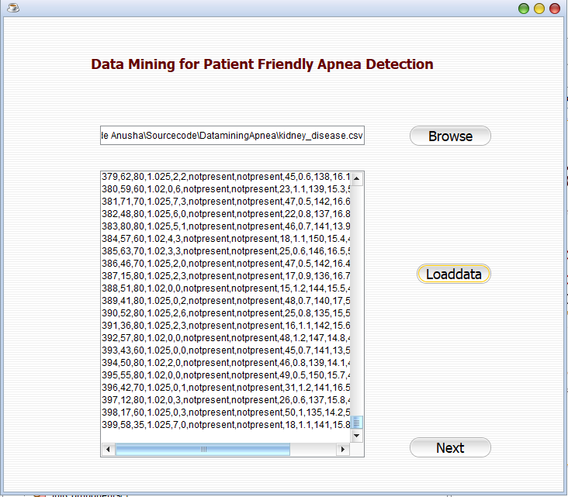

Slide 24
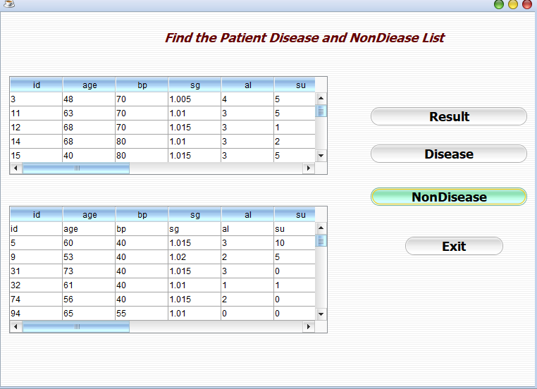

Slide 25
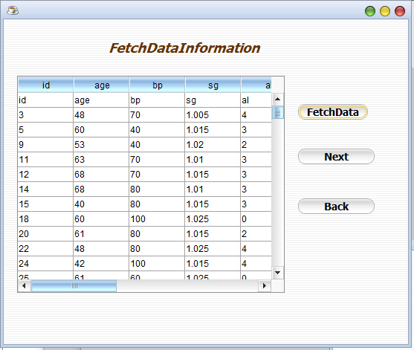

Slide 26
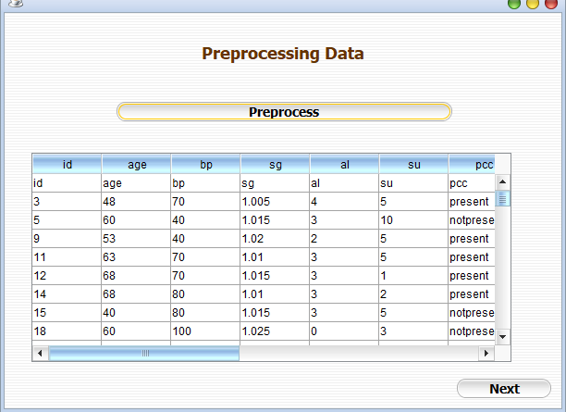

Slide 27
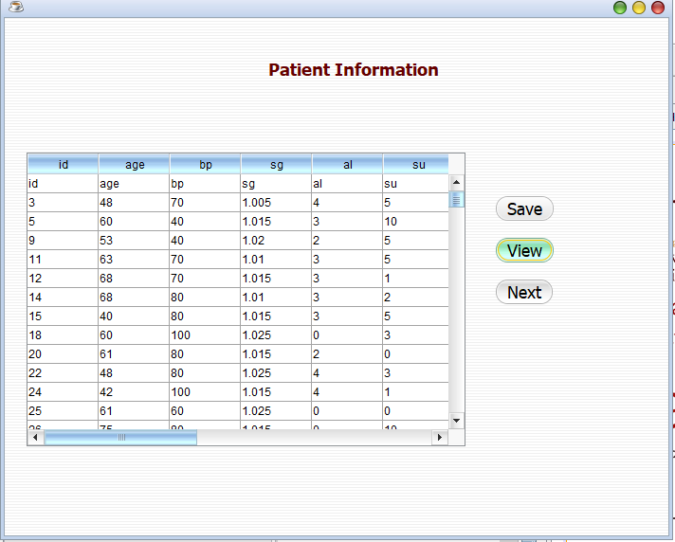

Slide 28
CONCLUSION
We can manage big data set with Knn algorithm.
We can find the exact solution in our project .
we get output affected patient list and non affected patient list.
we get awareness from this data and we defense the disease.

Slide 29
FUTURE ENHANCEMENT
In terms of future work, we would like to investigate how injecting external knowledge would improve the results. We investigate which signals from classical PSG diagnosis could be used to achieve reliable classification. The results show that classifying data from only a single sensor.

Slide 30
THANK YOU

